Slide 1

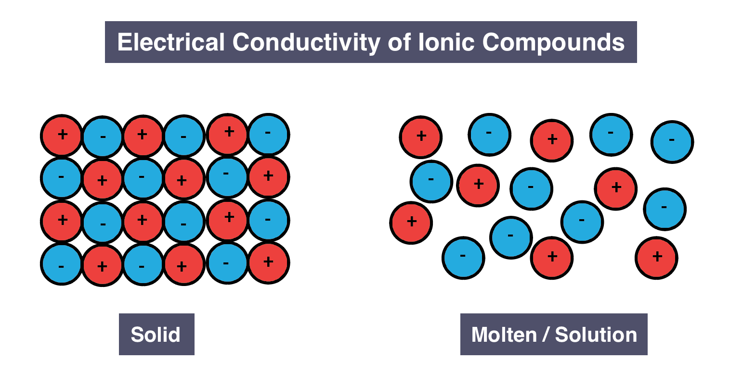
Experiment-9 Conductivity of ionic solid
By :- Sheelendra Agnihotri, Course in-charge ESO205

Slide 2
Objective
To understand the electrical conduction in ionic solid
To measure the resistivity variation of NaCl, an ionic material, with temperature and estimate the energy of vacancy migration and vacancy formation (in eV)
To measure room temperature resistivity of zirconia sample and report resistivity variation with temperature.
Apparatus
Alumina Crucible , Nacl , vertical Furnace, Electrode Connector, K-type Thermocouple (Chromel-Alumel), Mild Steel plate , Fireclay bricks Glass Wool,
Zirconia Sample, Probe Arrangement, PID controlled oven, PID controller High voltage power supply, Digital Pico ammeter,

Slide 3
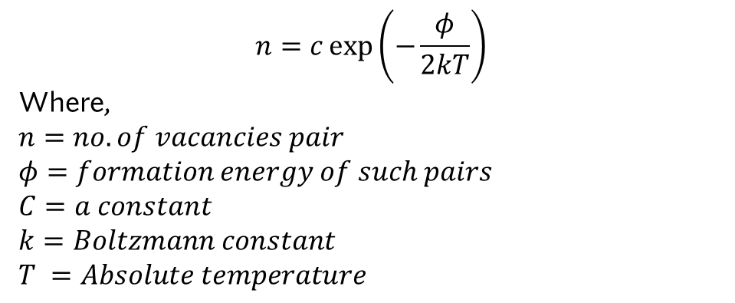
Theory
The electrical conductivity in ionic solids usually arises from the migration of ion under influences on an electric field. In this experiment Alkali halides, the positive ions are much mobile than negative one. the mobility of ion in a perfect lattice is extremely low because of high energy barrier preventing interchange of atom. due to presence of some lattice defects (like vacancy or interstitials is essential for the occurrence of ionic conductivity. the defect concentration is dependent on temperature
Thus, expression for the concentration of pair positive and negative ion vacancies is given
$$n=c\exp\left(−\frac{φ}{2kT}\right)$$
Where,
$n=no. of vacancies pair$
$φ=formation energy of such pairs$
$C=a constant$
$k=Boltzmann constant$
$T =Absolute temperature$

Slide 4
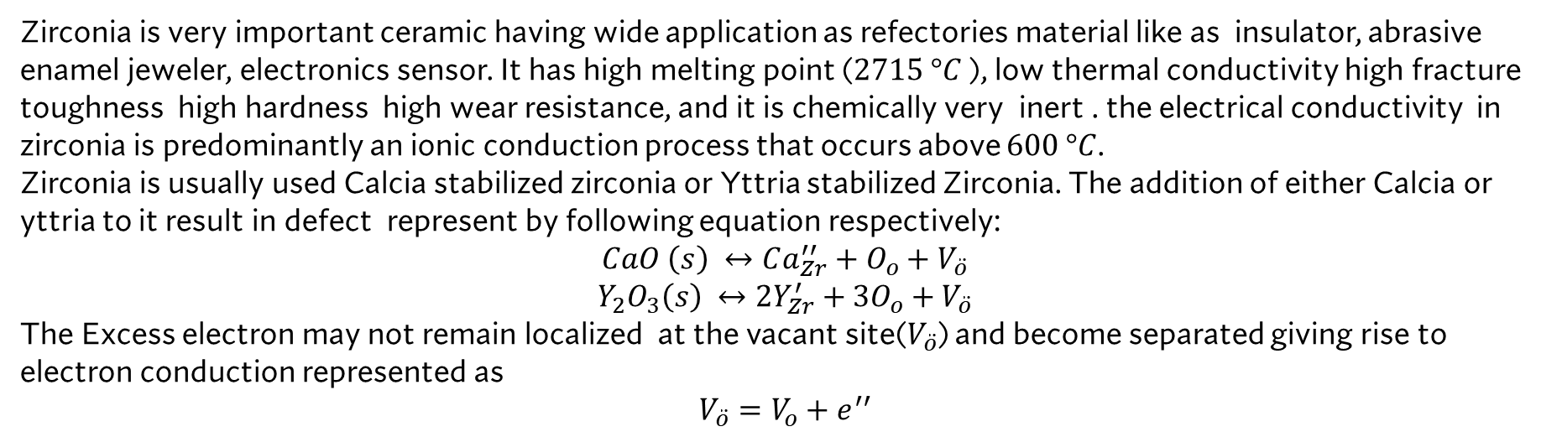
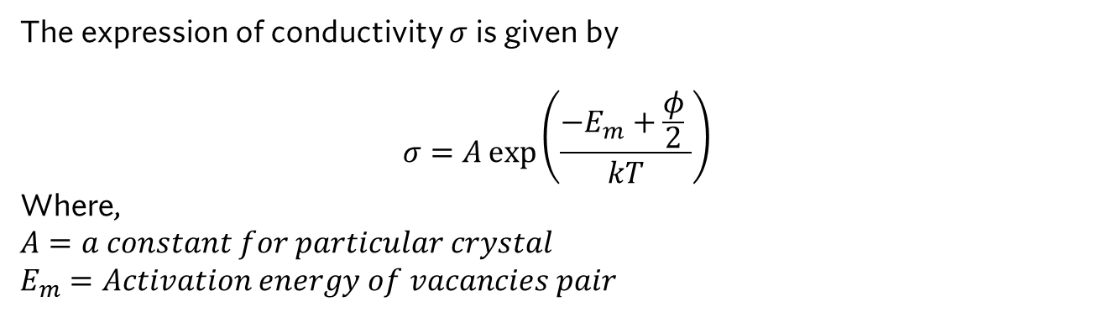
The expression of conductivity $σ$ is given by
$$σ=A\exp\left(\frac{−E_{m}+\frac{φ}{2} }{kT}\right)$$
Where,
$A=a constant for particular crystal$
$E_{m}=Activation energy of vacancies pair$
Resistivity of Zirconia
Zirconia is very important ceramic having wide application as refectories material like as insulator, abrasive enamel jeweler, electronics sensor. It has high melting point ($2715 °C$ ), low thermal conductivity high fracture toughness high hardness high wear resistance, and it is chemically very inert . the electrical conductivity in zirconia is predominantly an ionic conduction process that occurs above $600 °C$.
Zirconia is usually used Calcia stabilized zirconia or Yttria stabilized Zirconia. The addition of either Calcia or yttria to it result in defect represent by following equation respectively:
$$CaO \left(s\right) ↔Ca_{Zr}^{′′}+O_{o}+V_{\ddot{o}}$$
$$Y_{2}O_{3}\left(s\right) ↔2Y_{Zr}^{′}+3O_{o}+V_{\ddot{o}}$$
The Excess electron may not remain localized at the vacant site($V_{\ddot{o}}$) and become separated giving rise to electron conduction represented as
$$V_{\ddot{o}}=V_{o}+e^{′′}$$

Slide 5
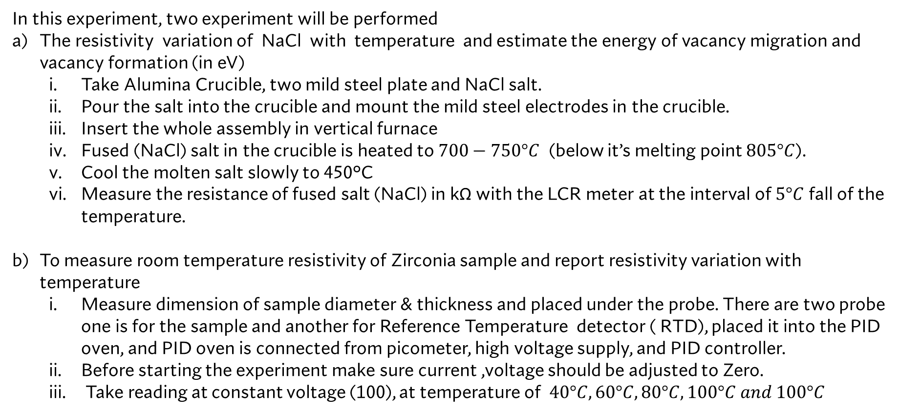
Methodology
In this experiment, two experiment will be performed
The resistivity variation of NaCl with temperature and estimate the energy of vacancy migration and vacancy formation (in eV)
Take Alumina Crucible, two mild steel plate and NaCl salt.
Pour the salt into the crucible and mount the mild steel electrodes in the crucible.
Insert the whole assembly in vertical furnace
Fused (NaCl) salt in the crucible is heated to $700−750°C$ (below it’s melting point $805°C$).
Cool the molten salt slowly to 450°C
Measure the resistance of fused salt (NaCl) in kΩ with the LCR meter at the interval of $5°C$ fall of the temperature.
To measure room temperature resistivity of Zirconia sample and report resistivity variation with temperature
Measure dimension of sample diameter & thickness and placed under the probe. There are two probe one is for the sample and another for Reference Temperature detector ( RTD), placed it into the PID oven, and PID oven is connected from picometer, high voltage supply, and PID controller.
Before starting the experiment make sure current ,voltage should be adjusted to Zero.
Take reading at constant voltage (100), at temperature of $40°C,60°C,80°C,100°C and 100°C$

Slide 6
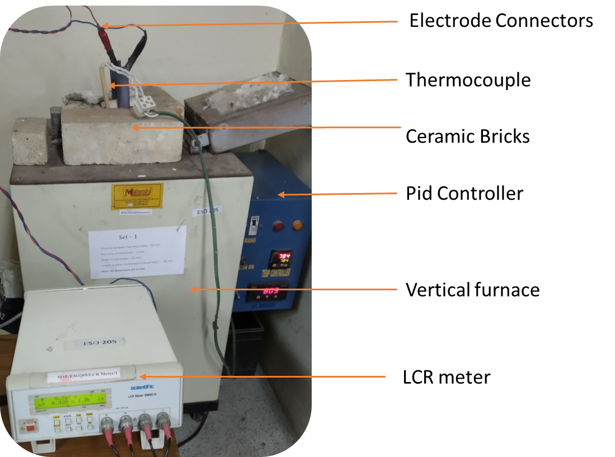
Experimental setup : Furnace

Slide 7
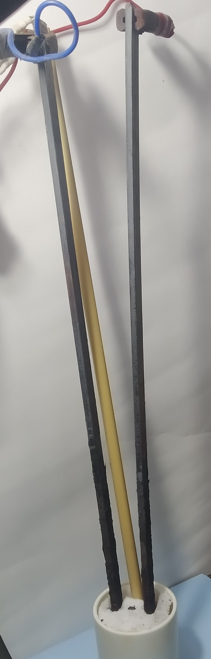
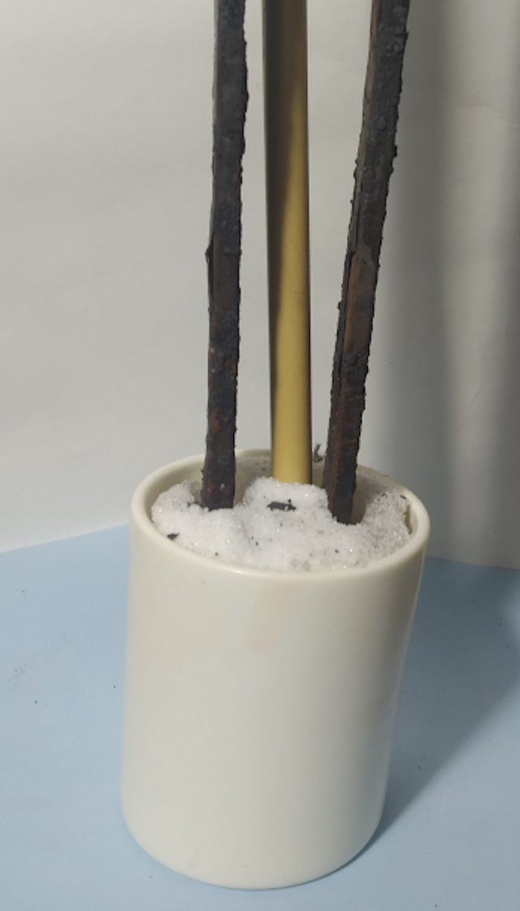
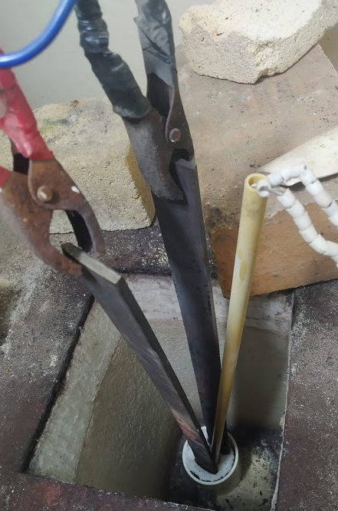
Experimental setup : Assembly
Plate immersed in fused Nacl length of plate(L)=70mm width of plate W ) = 20 thickness of plate (t)= 5mm
Distance between two electrodes (l)=18 mm
Assembled set up placed in to the vertical furnace

Slide 8
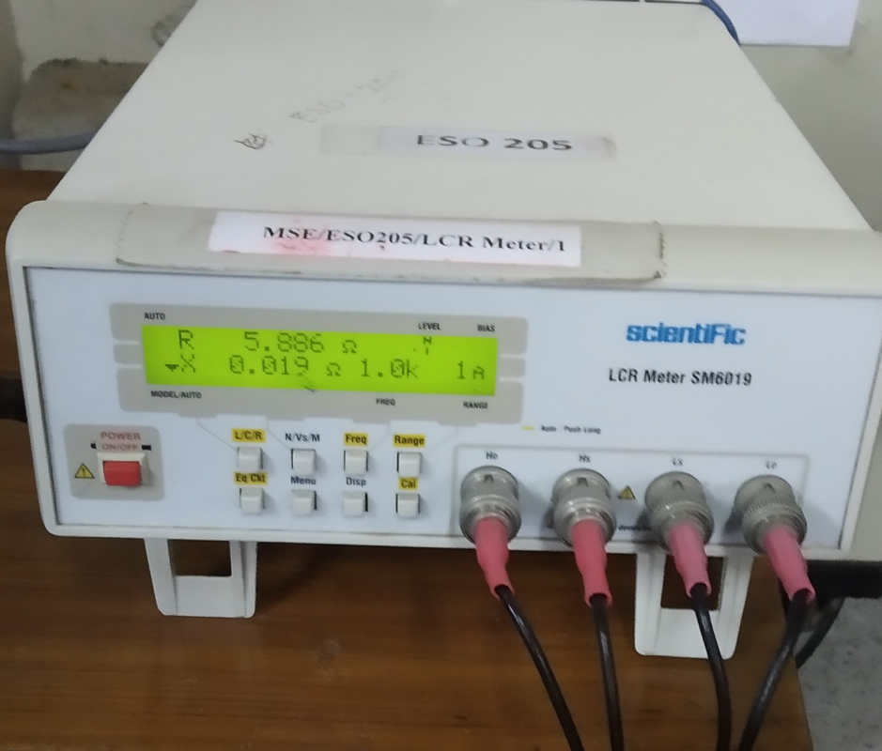
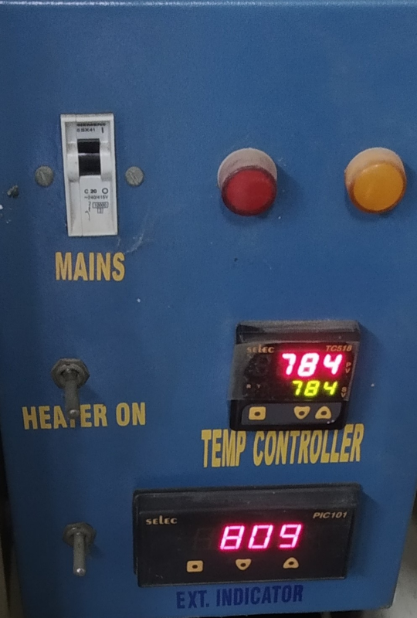
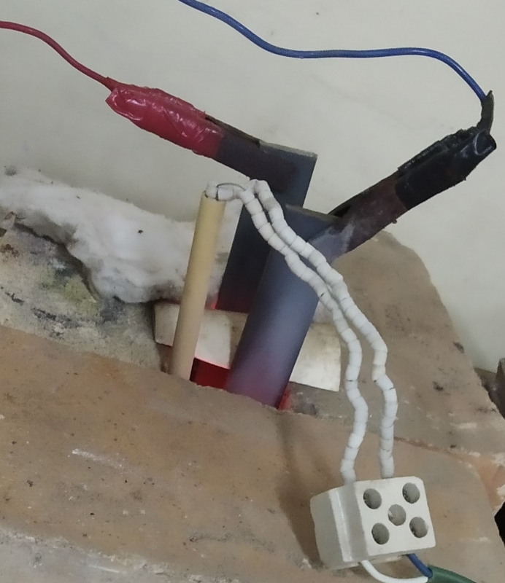
Electrode Connector
M S plate or electrodes
Thermocouple
LCR Meter
An LCR meter, is an electrical test instrument used to Measure the inductance (L),Capacitance (C), Resistance (R )
PID Controller
There are two temperature devices, one is the PID controller another is temperature indicator, temperature indicator measure the Fused Nacl temp. and PID Measure the furnace temperature

Slide 9
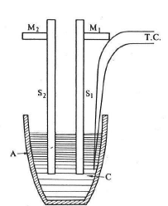
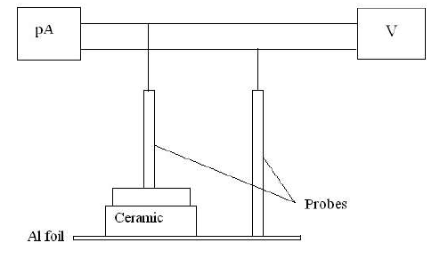
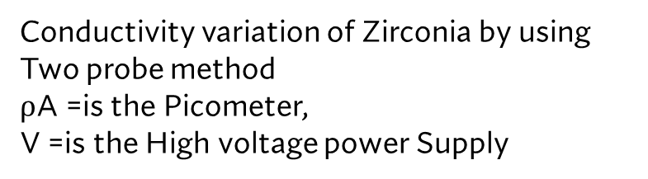
Schematic Diagrams
Ionic Conductivity of ionic solid
Two probe method
A alumina Crucible, C is polycrystalline Nacl, S₁ and S₂ are two mild steel plate for electrical conductivity act as electrode T.C represent the thermocouple wires.
Conductivity variation of Zirconia by using Two probe method
$⍴$A =is the Picometer,
V =is the High voltage power Supply

Slide 10
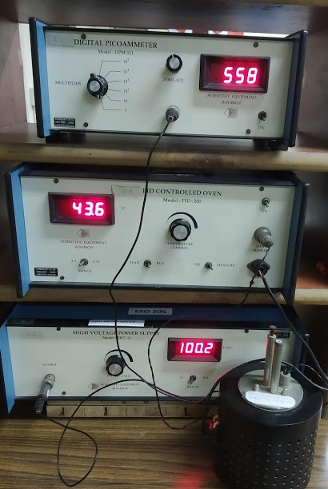
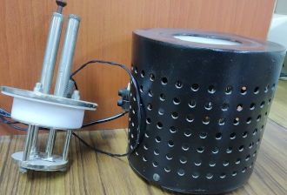
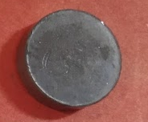
Experimental Setup : Resistivity of Zirconia
Digital Picometer
Oven
Probe Arrangement
Sample
PID Controller
Two probe
There are two probe one is sample probe, another is RTD probe
High Voltage Power Supply
Zirconia Sample
PID Oven

Slide 11
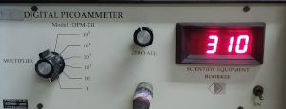
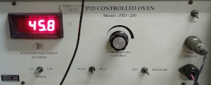
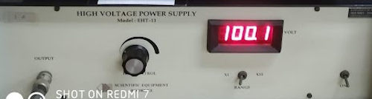
This is very versatile and general purpose instrument . The unit is specially for the measurement of current to1p.
Multiplier : X1, X102, X103, X104, X105.
Accuracy : 0.2% for all ranges.
Resolution :1pA, 10pA, 100pA, 1nA, 100nA,
Input Resistance :2.5kW, 0.25kw, 25W, 2.5W, 0.25W, 0.025W.
Display 3.5digit 7 segment LED (12.5 height) with auto polarity and decimal indication
This is high quality temperature-controlled oven suitable for the Two probe Set –Up. The oven has been designed for the fast heating and cooling rates. Platinum RTD sensor is use for sensing the Temperature. A Wheatstone bridge and instrument amplifier are used for signal conditioning. Temperature Ranges ambient to 200°C,and power rating 150W, resolution 0.1°C Measurement Accuracy is +/- 0.5 °C.
Range Switch at X1 side display reading would actually reading, when At X10 side range is to be multiplied by 10.
WAIT-RUN Switch- in wait mode the power to oven is OFF and RUN mode power to oven is ON. Temperature would be in Degree centigrade.
SET-MEASURE Switch –in set mode display the set Temp. and in MEASURE mode it display the Current Temperature
This is a fully solid-state power supply designed to meet the power requirement of broad range of Application . such as Radiation detector, photo-multiplier tubes ionization chamber, and where a high voltage source with high degree of regulation and stability is required
Out put : 1-1500 V continuously adjustable.
Current : 1mA max.
Polarity : Negative.
Power Requirement 220Vand 50HZ

Slide 12
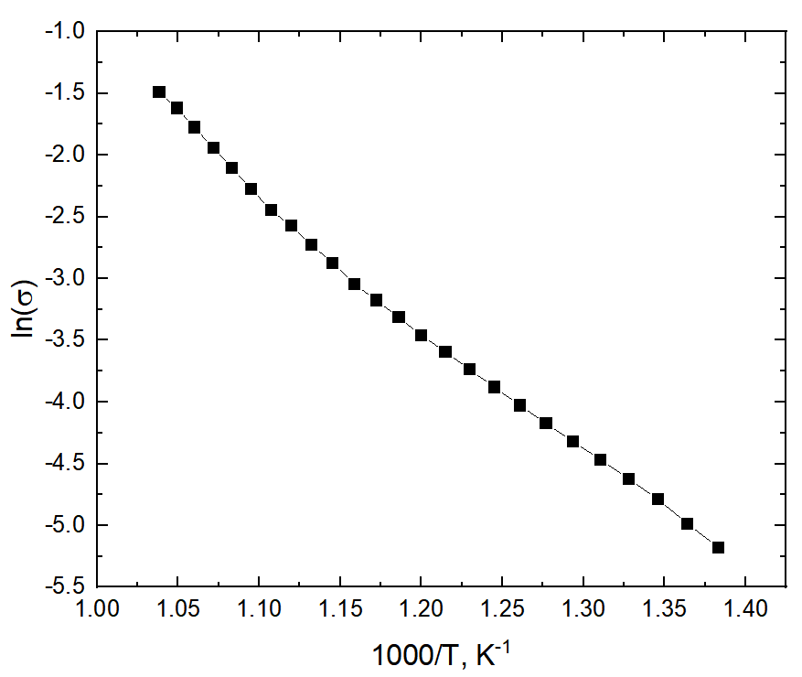
Test data obtained at lab
Temp.°c | Resistance Ω | Resistivity ρ | Conductivity ϭ | ln(ϭ) | 1000/T(K-1)
690 | 57.162 | 4.4459 | 0.225 | -1.4916 | 1.0384
680 | 65.011 | 5.056 | 0.1977 | -1.621 | 1.0493
670 | 75.915 | 5.9045 | 0.16936 | -1.775 | 1.06
660 | 89.836 | 6.9872 | 0.14311 | -1.944 | 1.0718
650 | 105.72 | 8.222 | 0.1216 | -2.106 | 1.834
640 | 125.46 | 9.758 | 0.1025 | -2.277 | 1.0953
630 | 148.76 | 11.57 | 0.0864 | -2.448 | 1.1074
620 | 168.64 | 13.116 | 0.0762 | -2.574 | 1.1198
610 | 197.65 | 15.372 | 0.065 | -2.73 | 1.1325
600 | 228.85 | 17.733 | 0.0564 | -2.875 | 1.1454
590 | 270.03 | 21 | 0.0476 | -3.045 | 1.1587
580 | 308.52 | 23.996 | 0.04167 | -3.177 | 1.1723
570 | 353.83 | 27.52 | 0.0363 | -3.316 | 1.1862
560 | 409.12 | 31.82 | 0.03142 | -3.46 | 1.2
550 | 468.34 | 36.426 | 0.02745 | -3.595 | 1.215
540 | 540.7 | 42.054 | 0.02377 | -3.739 | 1.23
530 | 622.97 | 48.453 | 0.02064 | -3.88 | 1.245
520 | 721.85 | 56.144 | 0.01781 | -4.028 | 1.261
510 | 836.69 | 65.076 | 0.01536 | -4.176 | 1.277
500 | 967.67 | 75.257 | 0.0133 | -4.319 | 1.2936
490 | 1120.11 | 87.119 | 0.01148 | -4.4671 | 1.3106
480 | 1309.3 | 101.834 | 0.00982 | -4.6233 | 1.328
470 | 1542.7 | 119.987 | 0.00833 | -4.7878 | 1.3459
460 | 1873.7 | 145.732 | 0.00686 | -4.985 | 13642
450 | 2281.4 | 177.442 | 0.00563 | -5.1786 | 1.3831
Details of plate immersed in fused NaCl
Length of plate(L)=80 mm
Width of plate (W ) = 25 mm
Thickness of plate (t)= 5 mm
Distance between two electrodes (l)=20 mm

Slide 13
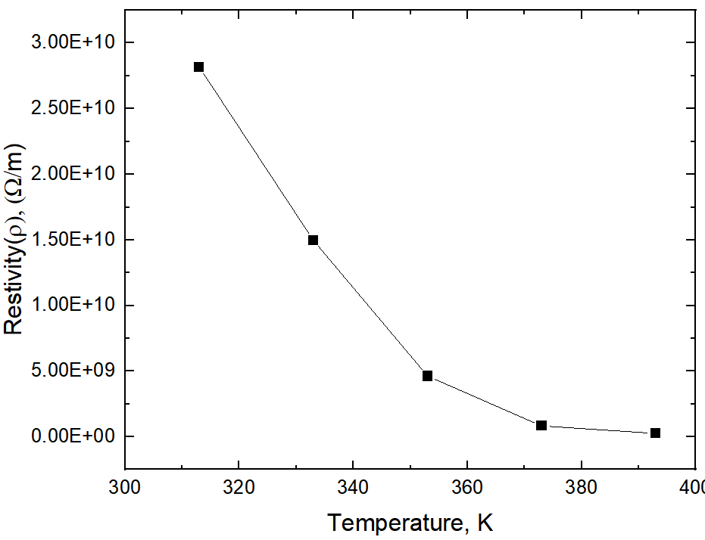
Die mention of Zirconia sample:
Thickness :2.07mm.
Diameter :7.85mm
Temperature °C | Current (Pico ampere) | temperature in (k) | Resistivity ρ ( ῼ/m)
40 | 83 | 313 | 2.817*10¹⁰
60 | 156 | 333 | 1.498*10¹⁰
80 | 506 | 353 | 4.6183*10⁹
100 | 2830 | 373 | 8.257*10⁸
120 | 9080 | 393 | 2.5735*10⁸
At constant voltage =100V

Slide 14
Observation
The slope of the graph decreases as the temperature decrease.
There is point when the slope get changed slightly this point is known as break point.
For Zirconia it is like a parabola, because it arise accordingly to a parabola Equation with Temperature.

Slide 15
Thank You

